Slide 1
Big Man Asteroids

Slide 2
Contents
World
Characters
Game Story
Mechanics

Slide 3
World
-The Year is 2154
-30 million people already inhabit extraterrestrial colonies and orbital habitats in the solar system
-Over the past decades, colonists have been sent to nearby solar systems
-The journey is a one way trip during which the colonists must be put into cryogenic hibernation
-One of those colonies is at star system Ortega. Automated factories and mining stations have already been established and a green-light is given for the 2nd wave of colonists to depart
-The 2nd wave of colonists are due to arrive 20-30 years after the green-light transmission
Notes:
Humanity has escaped the clutches of planetary life. Over 30 million people live in extraterrestrial habitats and colonies in the solar system. In the past century millions of colonists have embarked on journeys to new solar systems. Whether to run away and start anew or to seek out novel experiences, colonists must commit to the one way trip

Slide 4
Characters
Protagonist - Experienced pilot
Captain of the colony ship - The person giving you orders, telling you where to go
The Big Man himself - Final boss of the game (Not actually a man but is big)
Npc’s on colony ship - Shopkeeper, etc.

Slide 5
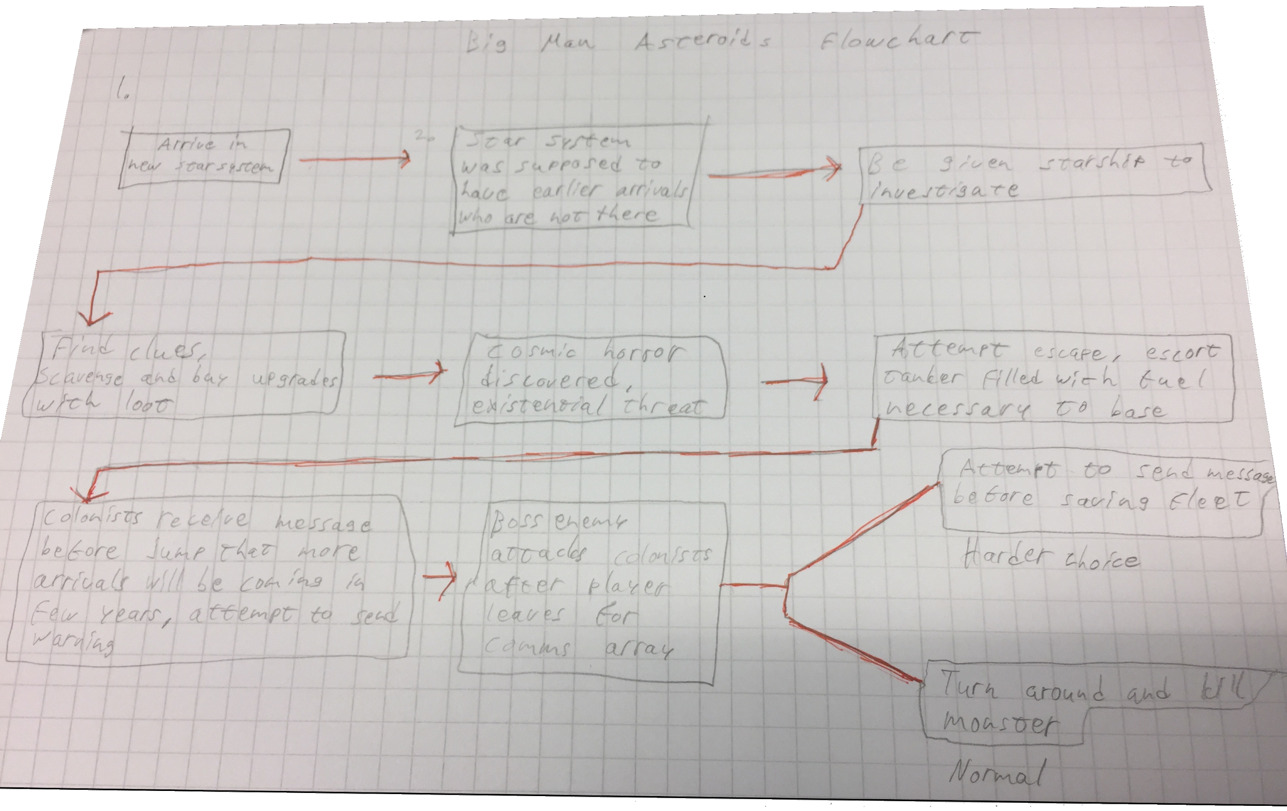
Act I
1: 2nd wave arrives at Ortega, but fail to make contact with the 1st wave. The player is forced to defend the colony ship from ships with familiar designs
2: After the attack, the colony mission is put on a hold until what is going on can be discerned. Player must go to nearby automated factory to gather supplies to buy the colony ship more time.

Slide 6
Act II
Act III
3: Encounter hostile aliens while following a signal that might give you information on what happened to the 1st wave of colonists. Realize the threat.
4: The colony ship needs to be refilled, since the decision was made to leave Ortega. The player must go to a mining station set up by the first wave in order to acquire that much needed fuel.
5: A dreaded escort mission with a tanker.
6: The player is sent on a mission to a communications array far away, but a horrible danger is closing in towards the colony ship.

Slide 7
Mechanics
Camera which follows the mouse
Scroll zoom
Tank controls with turret pointing towards the mouse
Train/rail style movement
Intelligent enemies with different ways of moving & attacking
Turret AI (friendly & not)
Different weapon & ship types
Variable rate of fire & bullet spread
Checkpoints after objectives
Shop for between objectives

